Slide 1
Improving routing security through concerted action
RIPE 80, May 12, 2020
Andrei Robachevsky
robachevsky@isoc.org

Slide 2
There is a problem (2019)
10,036 total incidents - either outages or attacks, like route leaks and hijacks
2.5% of all networks were affected by an outage
3.8% of all networks were affected by a routing incident
2% of all networks were responsible for 4232 routing incidents
Source: https://www.bgpstream.com/

Slide 3
Routing Incidents Cause Real World Problems
Event | Explanation | Repercussions | Example
Prefix/Route Hijacking | A network operator or attacker impersonates another network operator, pretending that a server or network is their client. | Packets are forwarded to the wrong place, and can cause Denial of Service (DoS) attacks or traffic interception. | The 2008 YouTube hijack April 2018 Amazon Route 53 hijack
Route Leak | A network operator with multiple upstream providers (often due to accidental misconfiguration) announces to one upstream provider that is has a route to a destination through the other upstream provider. | Can be used for a MITM, including traffic inspection, modification and reconnaissance. | November 2018. Google faced a major outage in many parts of the world thanks to a BGP leak. This incident that was caused by a Nigerian ISP MainOne. June 2019. Allegheny leaked routes from another provider to Verizon, causing significant outage.
IP Address Spoofing | Someone creates IP packets with a false source IP address to hide the identity of the sender or to impersonate another computing system. | The root cause of reflection DDoS attacks | March 1, 2018. Memcached 1.3Tb/s reflection-amplification attack reported by Akamai
Notes:
This is a summary of the following three slides. (Depending on the audience, you can use this one slide, OR the other three, and don’t need all four slides.)

Slide 4
Why routing security is so hard?
Each player can contribute to routing security
And be the cause of an incident
Most of them would like to have a more secure routing system
Routing incidents are hard to debug and fix
Most of them have little incentive
One’s network security is in the hands of others
We have a typical collective action problem

Slide 5
We Are In This Together
Network operators have a collective responsibility to ensure a globally robust and secure routing infrastructure.
Your network’s safety depends on a routing infrastructure that mitigates incidents from bad actors and accidental misconfigurations that wreak havoc on the Internet.
Security of your network depends on measures taken by other operators.
The more network operators work together, the fewer incidents there will be, and the less damage they can do.

Slide 6
Can this problem be solved without regulation?
Norms may provide a solution in some cases
Need to agree on values. And behaviors that support these values
Common Value
Resilient and secure global routing system
Behaviors
Do not accept and propagate others mistakes (Validate what you accept from the neighbors)
Protect your neighbors from your own mistakes (avoid policy violations)
Do not hijack
Do not leak
Enable others to validate

Slide 7
From Behaviors to Norms
Widely accepted as a good practice
Not exactly a least common denominator, but not too high either
Visible and Measurable

Slide 8
Mutually Agreed Norms for Routing Security (MANRS)
Provides crucial fixes to reduce the most common routing threats

Slide 9
Mutually Agreed Norms for Routing Security
MANRS provides baseline recommendations in the form of Actions
Distilled from common behaviors – BCPs, optimized for low cost and low risk of deployment
With high potential of becoming norms
MANRS builds a visible community of security minded operators
Social acceptance and peer pressure

Slide 10
MANRS – increasing adoption

Slide 11
Action – who can make an impact?
Enterprise and access networks
Transit providers
IXPs
CDNs and Cloud providers
IX
Transit
Access
Content Cloud

Slide 12
Network operators – MANRS launch, November 2014
Filtering Prevent propagation of incorrect routing information
Ensure the correctness of your own announcements and announcements from your customers to adjacent networks with prefix and AS-path granularity
Anti-spoofing Prevent traffic with spoofed source IP addresses
Enable source address validation for at least single-homed stub customer networks, their own end-users, and infrastructure
Coordination Facilitate global operational communication and coordination between network operators
Maintain globally accessible up-to-date contact information in common databases (RIR whois, IRR, PeeringDB)
Global Validation Facilitate validation of routing information on a global scale
Publish your data, so others can validate

Slide 13
MANRS IXP Programme
There is synergy between MANRS and IXPs
IXPs form communities with a common operational objective
MANRS is a reference point with a global presence – useful for building a “safe neighborhood”
How can IXPs contribute?
Implement a set of Actions that demonstrate the commitment of an IXP and bring significant improvement to the resilience and security of the peering relationships

Slide 14
MANRS IXP Actions
Action 1 Prevent propagation of incorrect routing information
This mandatory action requires IXPs to implement filtering of route announcements at the Route Server based on routing information data (IRR and/or RPKI).
Action 2 Promote MANRS to the IXP membership
IXPs joining MANRS are expected to provide encouragement or assistance for their members to implement MANRS actions.
Action 3 Protect the peering platform
This action requires that the IXP has a published policy of traffic not allowed on the peering fabric and performs filtering of such traffic.
Action 4 Facilitate global operational communication and coordination
The IXP facilitates communication among members by providing necessary mailing lists and member directories.
Action 5 Provide monitoring and debugging tools to the members.
The IXP provides a looking glass for its members.

Slide 15
MANRS IXP Program – launched in April 2018

Slide 16
The CDN and Cloud programme (launched on March 31))
Leverage their peering power, but also bring benefits:
Create a secure network peering environment, preventing potential attacks at their border
Encourage better routing hygiene from your peering partners
Signal organization security-forward posture
Demonstrate responsible behavior
Improve operational efficiency for peering interconnections, minimizing incidents and providing more granular insight for troubleshooting

Slide 17
The Task Force
Alejandro Becerra Gonzalez (Telefonica) Andrei Robachevsky (Internet Society, Editor) Arturo Servin (Google) Carlos Asensio (Nexica) Chris Morrow (Google) Christian Kaufmann (Akamai) Daniel Ponticello (Redder) | Gary Ratterree (Microsoft) Ibrahim Seremet (Verisign) Jerome Fleury (Cloudflare) JJ Crawford (Facebook) Kay Rechthien (Akamai) Kevin Blumberg (TORIX) Marcus Grando (Azion) Martin J. Levy (Cloudflare) Marty Strong (Facebook) | Rob Spiger (Microsoft) Rogério Mariano (Azion) Ronan Mullally (Akamai) Ray Sliteris (Facebook) Steve Peters (Facebook) Tale Lawrence (Oracle) Tony Tauber (Comcast) Yong Kim (Verisign)

Slide 18
MANRS Actions for CDN&Cloud
Action 1 Prevent propagation of incorrect routing information
Egress filtering
Ingress filtering – non-transit peers, explicit whitelists
Action 2 Prevent traffic with illegitimate source IP addresses
Anti-spoofing controls to prevent packets with illegitimate source IP address
Action 3 Facilitate global operational communication and coordination
Contact information in PeeringDB
and relevant RIR databases
Action 4 Facilitate validation of routing information on a global scale
Publicly document ASNs and prefixes that are intended to be advertised to external parties.
Action 5 Encourage MANRS adoption
Actively encourage MANRS adoption among the peers
Action 6 Provide monitoring and debugging tools to peering partners
Provide monitoring tools to indicate incorrect announcements from peers that were filtered by the CDN&Cloud operator.

Slide 19
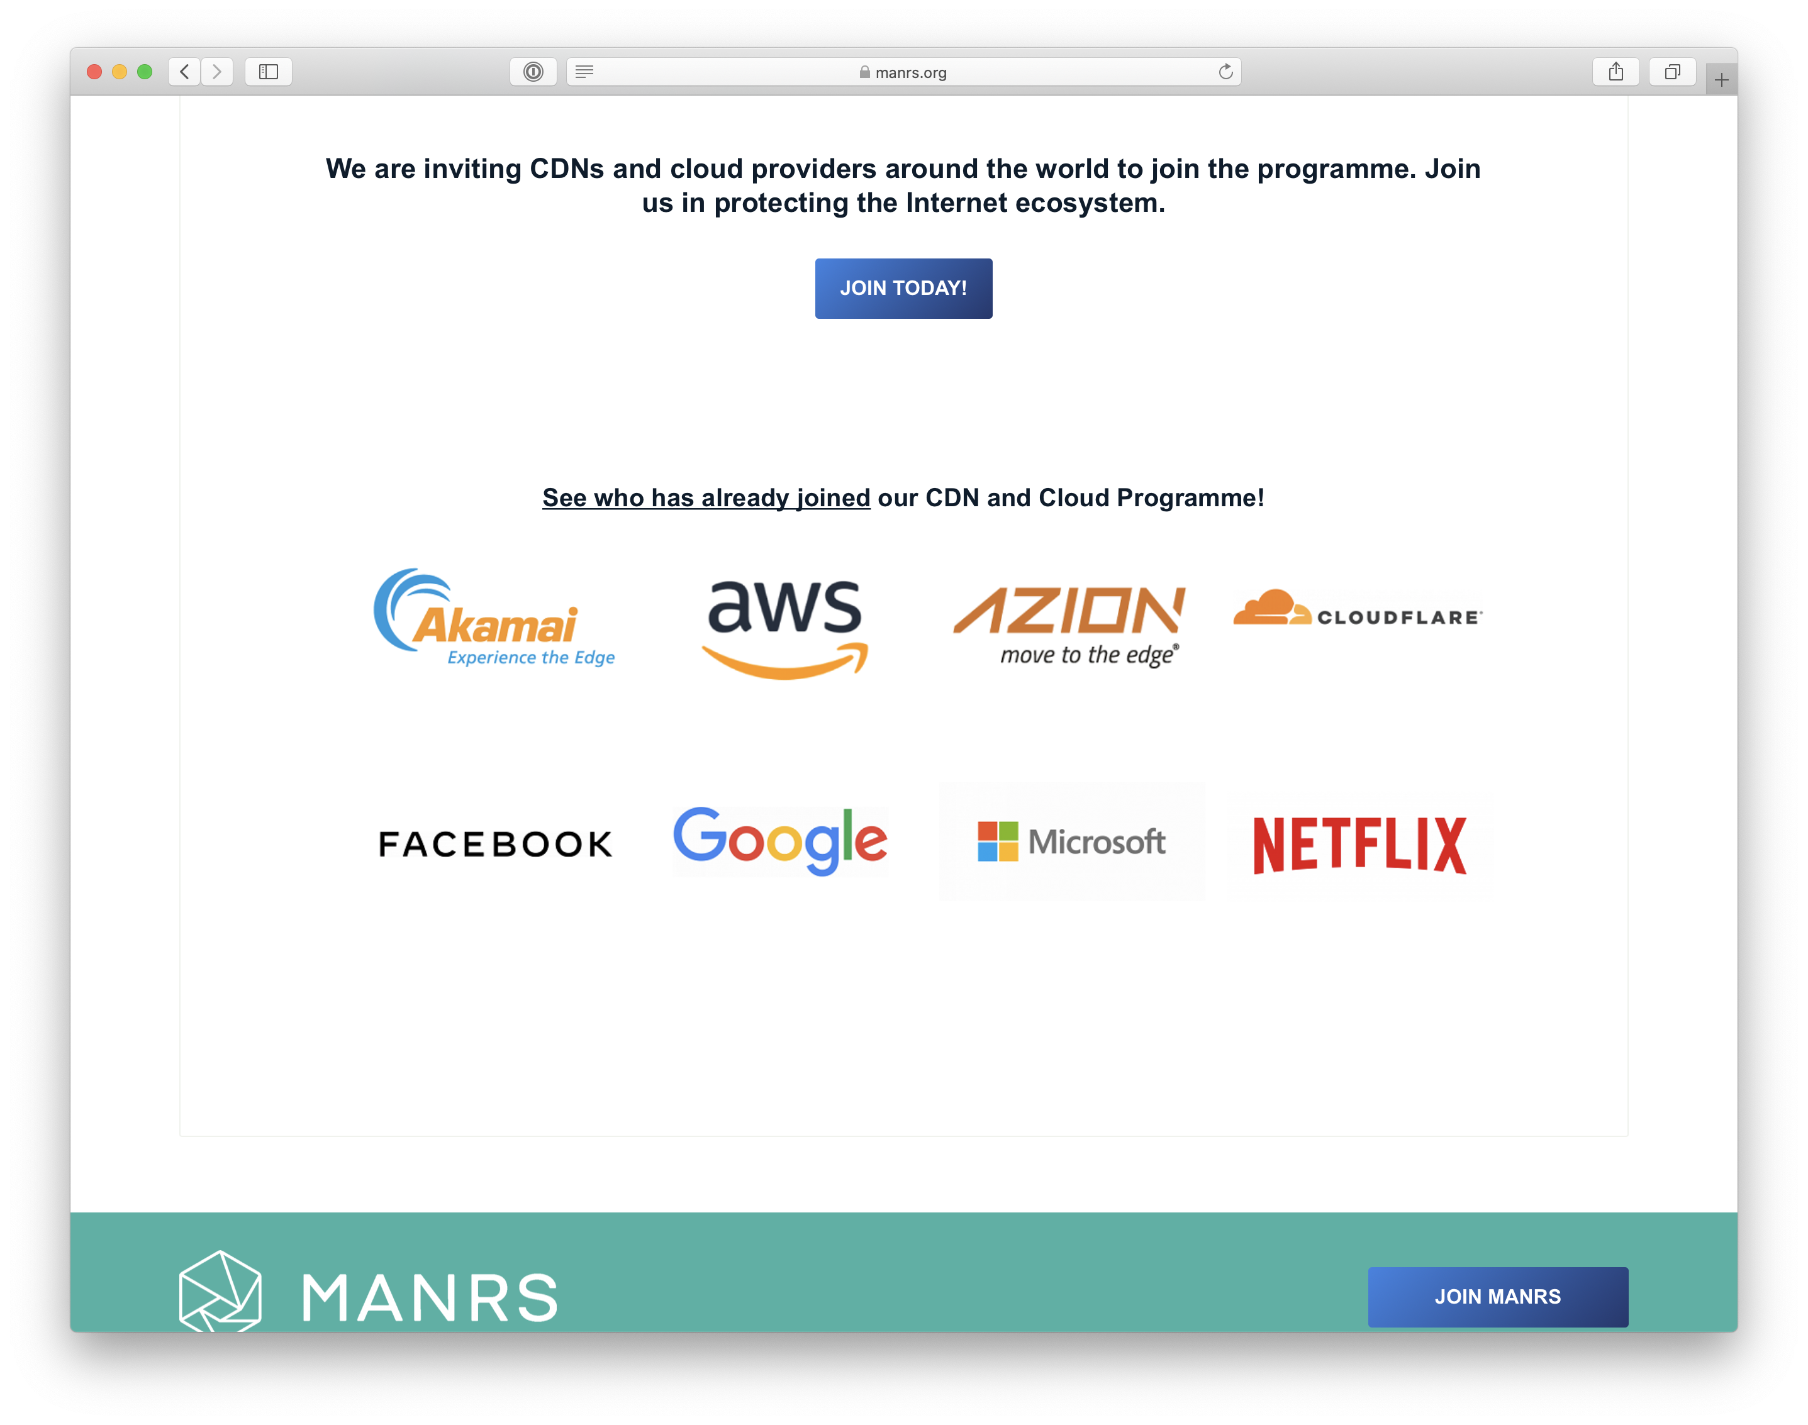

Slide 20
300
364 ISPs
300
52 IXPs
8 CDN&Clouds
200
100
9
50
9

Slide 21
Demography of participants (ISPs)

Slide 23
Measuring MANRS Readiness
MANRS Observatory

Slide 24
Motivation
Inform MANRS members about their degree of commitment
Improve reputation and transparency of the effort
Facilitate continuous improvement and correction
Provide a factual state of routing security as it relates to MANRS
Support the problem statement with data
Demonstrate the impact and progress
Network, country, region, over time
Improve robustness of the evaluation process
Make it more comprehensive and consistent
Reduce the load
Allow preparation (self-assessment)

Slide 25
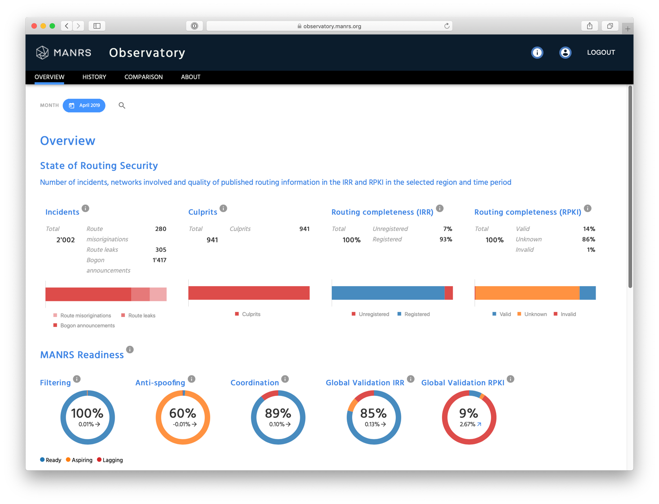
MANRS Observatory
Provides a factual state of routing security as it relates to MANRS

Slide 26
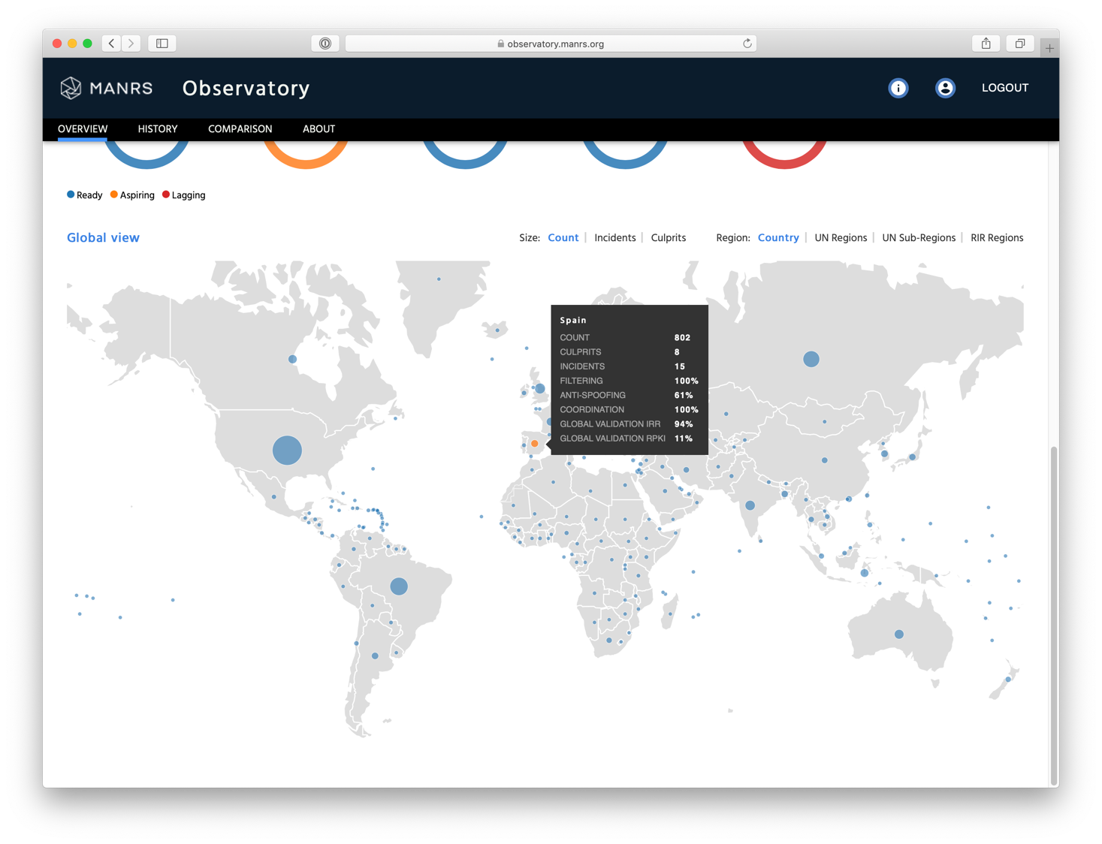
MANRS Observatory
Provides a factual state of routing security as it relates to MANRS

Slide 27
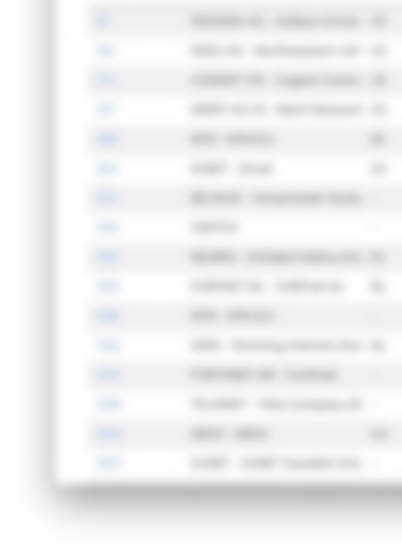
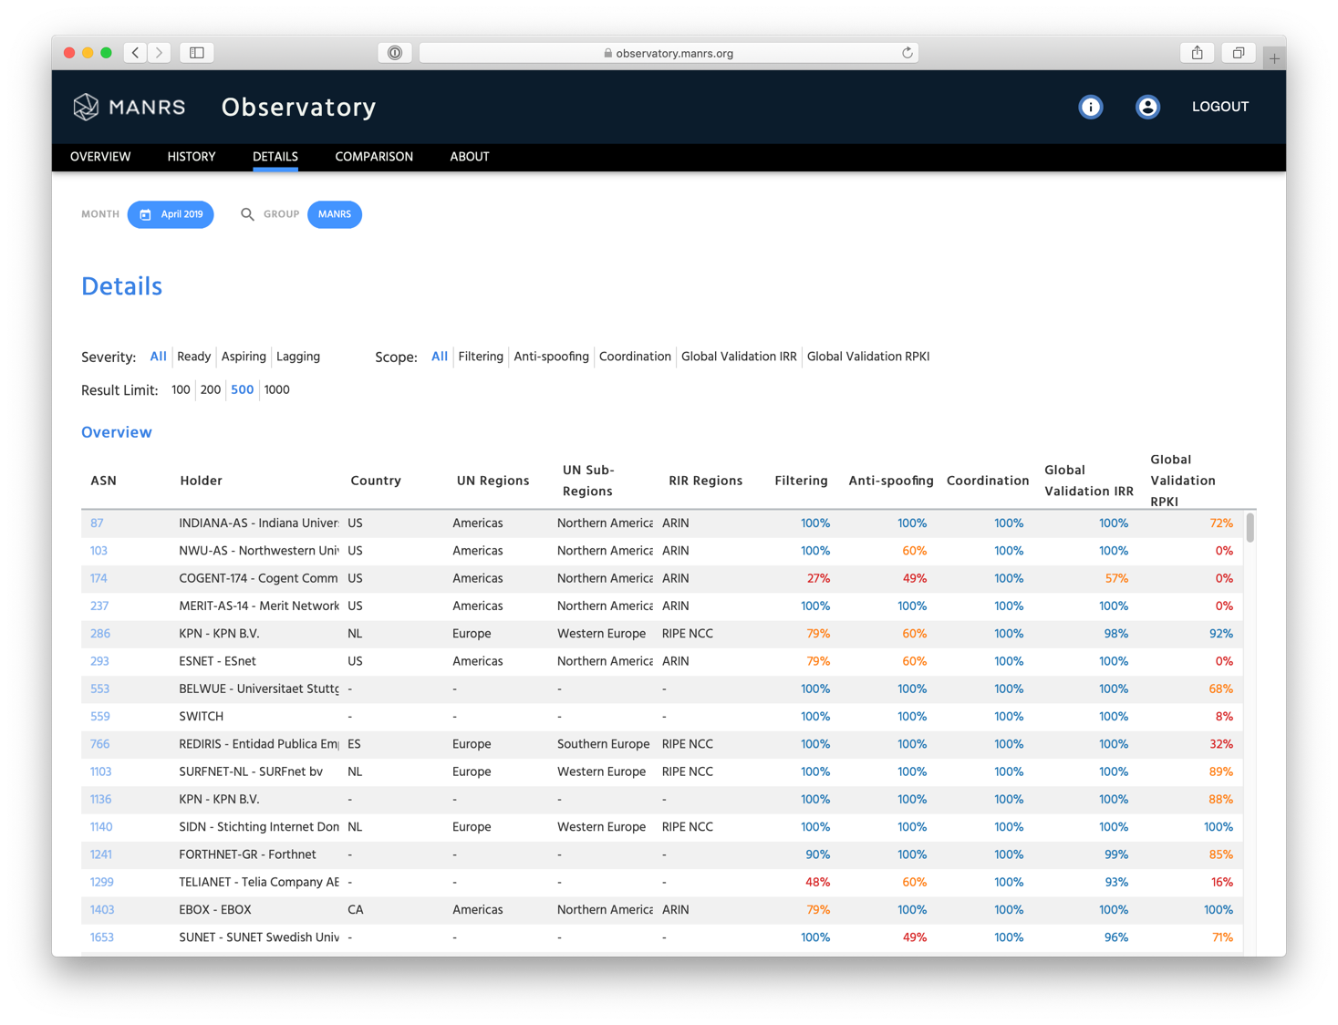
MANRS Observatory
Informs MANRS members about their degree of commitment

Slide 28
MANRS is an Important Step
Security is a process, not a state. MANRS provides a structure and a consistent approach to solving security issues facing the Internet.
MANRS is the minimum an operator should consider, with low risk and cost-effective actions.
MANRS is not a one-stop solution to all of the Internet’s routing problems, but it is an important step toward a globally robust and secure routing infrastructure.

Slide 29
Why join MANRS?
Improve your security posture and reduce the number and impact of routing incidents
Demonstrate that these practices are reality
Meet the expectations of the operators community
Join a community of security-minded operators working together to make the Internet better
Use MANRS as a competitive differentiator

Slide 30
Join Us
Visit https://www.manrs.org
Fill out the sign up form with as much detail as possible.
We may ask questions and run tests
Get Involved in the Community
Members support the initiative and implement the actions in their own networks
Members maintain and improve the document and promote MANRS objectives

Slide 31
manrs.org
#ProtectTheCore
MANRS Observatory:
https://observatory.manrs.org

Slide 32
Questions?
https://www.manrs.org
Feedback: manrs@isoc.org

